Slide 1


Conformal Prediction Intervals: Empowering Executives for Informed Decisions
Matthew Kolakowski, Ph.D.
LinkedIn: https://www.linkedin.com/in/datascientistmk84

Slide 2
The Complexity of Forecasting
Forecasting can get overlooked as a straightforward endeavor due to the illusion of validity—my favorite example is selecting candidates for a given position. Say you construct this instrument with acceptable construct, criterion, discriminant, predictive, content, and external validity (Note: Top Quality Instrumentation).
Let’s take an example from Noise: A Flaw in Human Judgment by Daniel Kahneman (2002 Nobel Prize in Economic Sciences shared with Vernon L. Smith), Olivier Sibony, and Cass R. Sunstein. It starts on Page 111 of the hardcover text if you own this book. If not, it is a masterpiece on human judgment (Which impacts the quality of forecasts).

Slide 3
How Good Is Your Intuition?
Monica and Nathalie's scores on an instrument that predicts performance are as follows: Monica (Leadership-4, Communication-6, Interpersonal Skills-4, Technical Skills-8, Motivation-8)/Nathalie (Leadership-8, Communication-10, Interpersonal Skills-6, Technical Skills-7, Motivation-6).
30 for Monica and 37 for Nathalie for those keeping score at home. 7.4 average for Nathalie and 6 for Monica. This component is called clinical judgment (Quick calculation, consulting your intuition, and deciding). Now, the clinical predictions .15 with performance evaluations (PC = 55%) performed by terminally degreed psychologists (Likely Industrial and Organizational Psychologists). 5% above chance (Chance = 50%).
Reference: Noise, A Flaw in Human Judgment. Daniel Kahneman, Olivier Sibony, and Cass R. Sunstein. Link: https://www.amazon.com/Thinking-Fast-Slow-Daniel-Kahneman/dp/0374533555

Slide 4
Mechanical Prediction Methods Must Be Better?
So, given a valid instrument, Nathalie's mechanical prediction (The forecasting/prediction) portion yields a correlation of .32 (PC = 60%). Hey, now we are at least 10% above chance.
As a forecaster, dealing with noise is an unavoidable reality. It is necessary to differentiate between relevant and irrelevant information when making predictions. Unfortunately, no foolproof method exists for separating the two. However, conformal prediction intervals are a valuable tool in helping to simplify the already complex task of sorting out predictions generated by forecasting. It is important to note that while conformal prediction intervals are helpful, they are not a cure-all solution.
References: Noise, A Flaw in Human Judgment. Daniel Kahneman, Olivier Sibony, and Cass R. Sunstein. Link: https://www.amazon.com/Thinking-Fast-Slow-Daniel-Kahneman/dp/0374533555
Demand Forecasting for Executives and Professionals, Chapter 16: https://dfep.netlify.app/sec-judgment

Slide 5
Why Conformal Prediction Intervals
Enhanced Decision Making: Accurate prediction uncertainty can aid in strategic decision-making, optimizing results, and reducing risks.
Adaptability: Conformal Prediction is distribution-free, unlike methods requiring strong assumptions about the data. This makes it versatile and adaptable to various applications and datasets.
Reliability: Many prediction methods only offer a single estimate, which can be confusing for users as it doesn't indicate how reliable that estimate may be. On the other hand, Conformal Prediction provides a more structured approach by offering prediction intervals. This gives a clearer picture of the expected range in which the actual value is likely to lie.
Reference: Conformal Prediction forecasting with Nixtla’s statsforecast. Link: https://valeman.medium.com/conformal-prediction-forecasting-with-nixtlas-statsforecast-cc39b9e30b36

Slide 6
Conformal Prediction Intervals Summary
Conformal Prediction is a process that involves assigning a confidence level to each prediction made. This ensures that the prediction error is only outside the confidence interval for a fraction of the time corresponding to (1-confidence level). In simpler terms, if a prediction is made with 95% confidence, there is a 95% probability that the actual value will fall within the bounds of the prediction interval.
Conformal Prediction produces prediction intervals with a precise level of coverage specified by the user. For example, if a 95% prediction interval is generated using this method, we can be 95% sure that the actual value will lie within that prediction interval.
Reference: Conformal Prediction forecasting with Nixtla’s statsforecast. Link: https://valeman.medium.com/conformal-prediction-forecasting-with-nixtlas-statsforecast-cc39b9e30b36

Slide 7
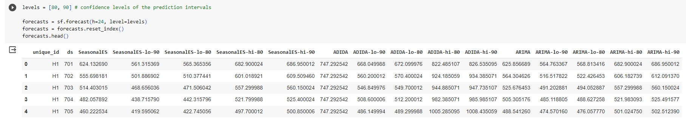
Conformal Prediction Interval Example
H: An integer that represents the forecasting horizon. In this case, we’ll forecast the next 24 hours.
Level: A list of floats with the confidence levels of the prediction intervals. For example, level=[90] means that the range of values should include the actual future value with a probability of 90%.
Reference: Conformal Prediction forecasting with Nixtla’s statsforecast. Link: https://valeman.medium.com/conformal-prediction-forecasting-with-nixtlas-statsforecast-cc39b9e30b36

Slide 8
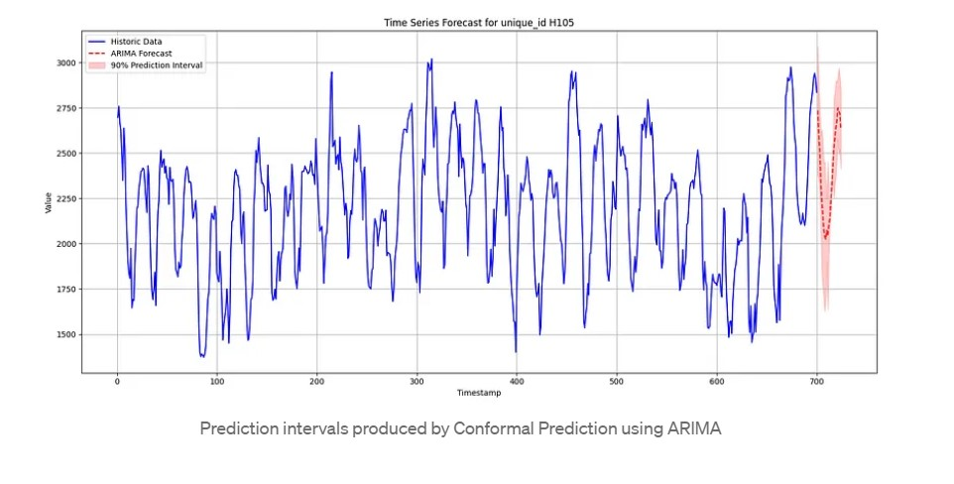
Why Is This Important
Rather than leveraging MAPE (Mean Absolute Percentage Error), conformal prediction intervals provide practical and theoretical guarantees that the actual value (What we care about when forecasting) will lie within the prediction interval 90% of the time (Note: This example utilizes a 90% Prediction Interval. You can utilize 80%, 85%, 90%, 95%, or 99%)
Reference: Conformal Prediction forecasting with Nixtla’s statsforecast. Link: https://valeman.medium.com/conformal-prediction-forecasting-with-nixtlas-statsforecast-cc39b9e30b36

Slide 9
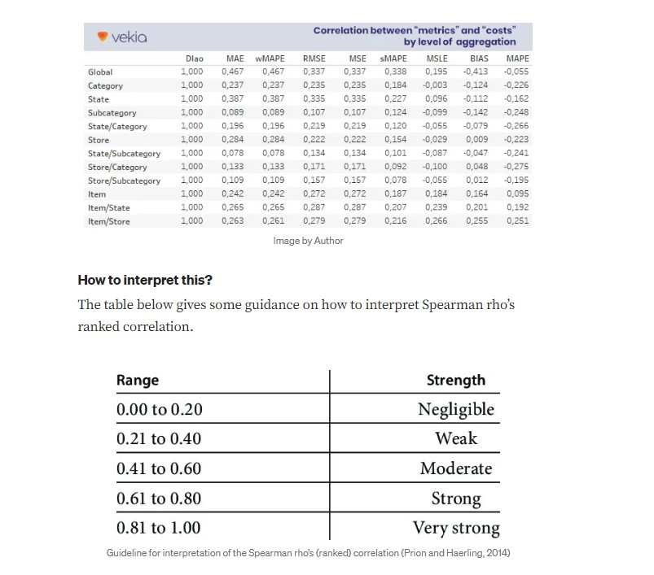
What’s the Rub with MAPE?
Here is the bad news. I will do something other than prescribe or recommend precisely what you should do. I will offer the evidence below and let the conversation transpire between your executives and the data team.
Keeping Score on MAPE: No Ranked Correlation Rises Above the Moderate Range
Reference: What’s the hidden cost of a forecast accuracy metric? - Insights from the M5-competition. Link: https://towardsdatascience.com/whats-the-hidden-cost-of-a-forecast-accuracy-metric-64ee0b86ce25
Reference on MAPE Limitations: https://blog.arkieva.com/two-sides-of-the-mape-coin/#:~:text=MAPE%20does%20not%20provide%20a,more%20important%20than%20the%20other

Slide 10
What Did The Author Find?
MAPE, often acknowledged as the most used forecasting metric, is the worst metric in this context, having a negligible to weak correlation to costs.
Reference: What’s the hidden cost of a forecast accuracy metric? - Insights from the M5-competition. Link: https://towardsdatascience.com/whats-the-hidden-cost-of-a-forecast-accuracy-metric-64ee0b86ce25

Slide 11
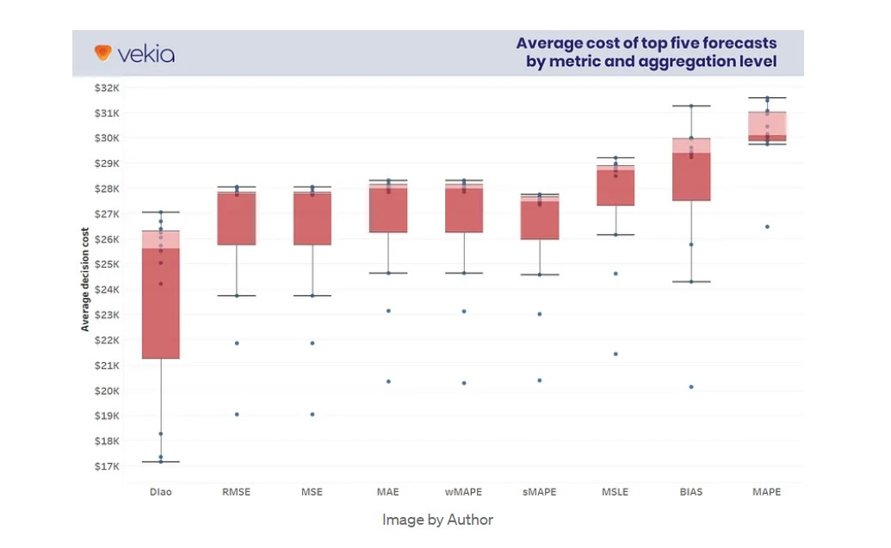
Show Me the Money!
MAPE-selected forecasts are more expensive than any other metric with an average value of respectively $35k and $30k.
Our forecast period includes $2.88 million in sales, representing 0.00052% of Walmart’s 2020 annual revenue of $138.34 billion.
Reference: What’s the hidden cost of a forecast accuracy metric? - Insights from the M5-competition. Link: https://towardsdatascience.com/whats-the-hidden-cost-of-a-forecast-accuracy-metric-64ee0b86ce25

Slide 12
Summary of Potential Costs of Suboptimal Forecasting Metrics
What did Johann Robette’s study find as the potential cost summary of utilizing MAPE as the principal forecasting metric?
$9.3K for 3049 items in 10 stores for three weeks
35.2% of total replenishment costs
$5.29/year for each item and store
$1.805 billion/year at Walmart scale
0.32% of the annual turnover
1.30% of Walmart’s annual gross revenue
Reference: What’s the hidden cost of a forecast accuracy metric? - Insights from the M5-competition. Link: https://towardsdatascience.com/whats-the-hidden-cost-of-a-forecast-accuracy-metric-64ee0b86ce25

Slide 13
Is Conformal Prediction A Fad?
Naturally, questions arise when an alternative is presented for a long-standing practice like using MAPE to assess forecasting accuracy. The advantage of conformal prediction is that its 25th Anniversary is being celebrated.
Second, as we speak, conformal prediction is being used in industry.
Third, the prevalence of open-source Python, R, and Julia libraries (Nixtla and MAPIE, to name a few) make the tool accessible to data science teams without significant infrastructure or proprietary software (Think SAS, SPSS, Stata, and Off the Shelf (OTS) Forecasting Solutions).
Reference: Gammerman, A., Vapnik, V., & Vovk, V. (1998). Learning by transduction. In Proceedings of the Fourteenth Conference on Uncertainty in Artificial Intelligence, pp. 148–156, San Francisco, CA. Morgan Kaufmann.

Slide 14
Is Conformal Prediction Intensive- Programmatically?
No. If Matthew Kolakowski can leverage conformal prediction intervals, so can your data science team. Let’s take a quick look at an example written by Valeriy Manokhin and the Nixtla Team. For the sake of quick access, I transposed the example from the Nixtla GitHub page and included it in an easy-to-access Google Colab Notebook: https://github.com/MatthewK84/MattConformalPrediction/blob/main/Conformal_Prediction.ipynb
Let’s take a few minutes to go over the link above.
Reference: Valeriy Manokhin and Nixtla. Link: https://nixtla.github.io/statsforecast/docs/tutorials/conformalprediction.html

Slide 15
What Is The Executive Takeaway on Conformal Prediction Intervals?
No amount of mechanical or clinical judgment will remove noise (variability that does not correlate with the outcome) from your forecasts and predictions when market forces, human variability, and complex socioeconomic conditions exist.
What conformal prediction intervals offer is a theoretical, practical, accessible, and low-cost alternative to assessing the validity of your forecasting predictions. Can this presentation guarantee that conformal prediction intervals work in every use case and industry? No.
Opportunities exist to improve forecasting metrics by utilizing conformal prediction intervals. Take the opportunity to discuss conformal prediction with your data science team and perhaps integrate it into a subset of your forecasting models. You might like the results and prediction clarity it yields.
Reference: Noise, A Flaw in Human Judgment. Daniel Kahneman, Olivier Sibony, and Cass R. Sunstein. Link: https://www.amazon.com/Thinking-Fast-Slow-Daniel-Kahneman/dp/0374533555

Slide 16
Thank You For Your Time Today!
Comprehensive Conformal Prediction Resource: https://github.com/valeman/awesome-conformal-prediction

